Slide 1
To create double-sided pocket cards, print the page and fold it in half at the orange arrow. Laminate the folded page, and then cut out the cards. Stack the cards together, and use a hole punch in the corner to add a ring.
Space has been provided on the last card of each set if you would like to add your agency’s logo.
The professional InDesign file is also available upon request at HHQI@qualityinsights.org.

Slide 2
To create double-sided pocket cards, print the page and fold it in half at the orange arrow. Laminate the folded page, and then cut out the cards. Stack the cards together, and use a hole punch in the corner to add a ring.
Space has been provided on the last card of each set if you would like to add your agency’s logo.
The professional InDesign file is also available upon request at HHQI@qualityinsights.org.

Slide 3
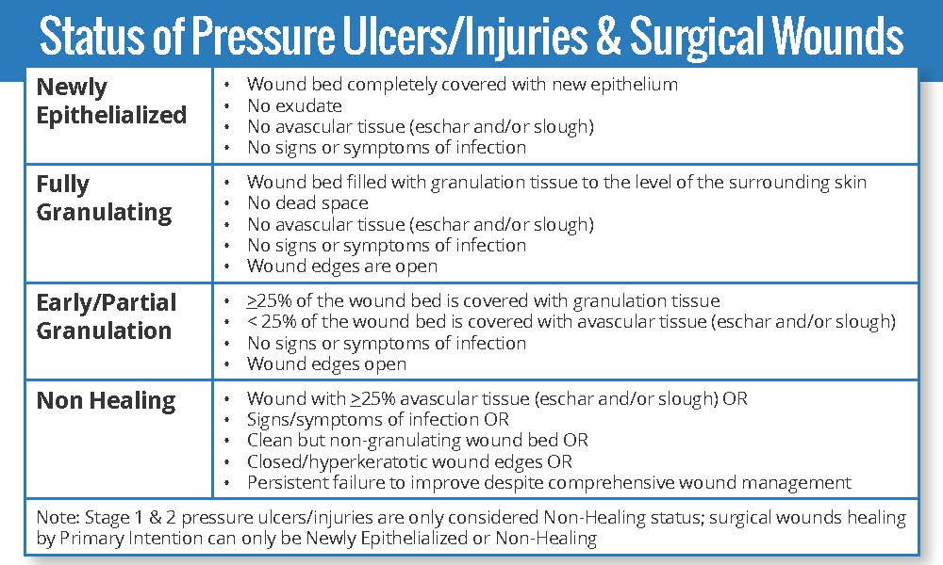
To create double-sided pocket cards, print the page and fold it in half at the orange arrow. Laminate the folded page, and then cut out the cards. Stack the cards together, and use a hole punch in the corner to add a ring.
Space has been provided on the last card of each set if you would like to add your agency’s logo.
The professional InDesign file is also available upon request at HHQI@qualityinsights.org.

Slide 4
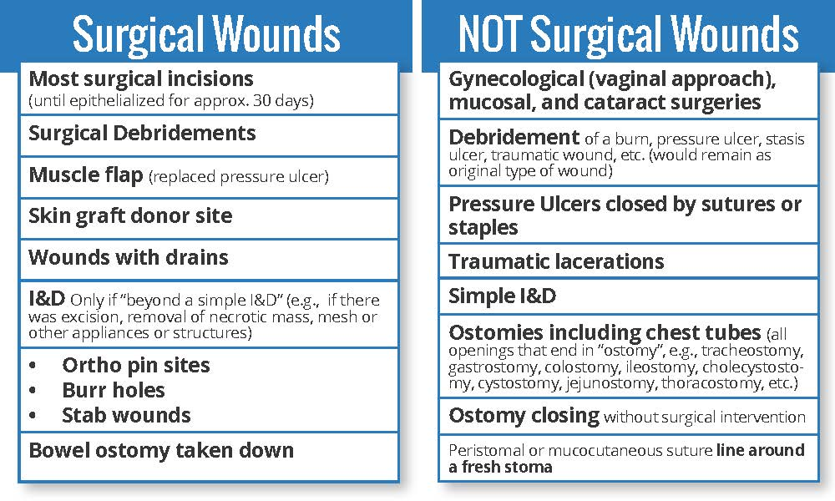
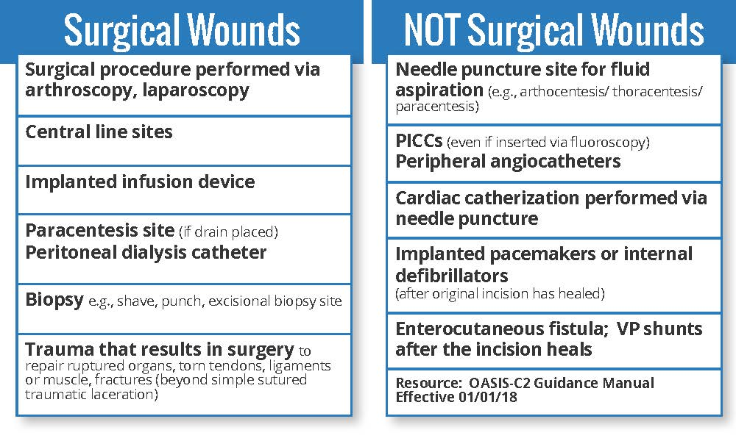
To create double-sided pocket cards, print the page and fold it in half at the orange arrow. Laminate the folded page, and then cut out the cards. Stack the cards together, and use a hole punch in the corner to add a ring.
Space has been provided on the last card of each set if you would like to add your agency’s logo.
The professional InDesign file is also available upon request at HHQI@qualityinsights.org.

